Slide 1
"Happy" Scheduling
An easy way to maximize students' happiness and TA's satisfaction
Team 'Orange'
ql2176 Qing Liu yl2774 Yifan Li

Slide 2
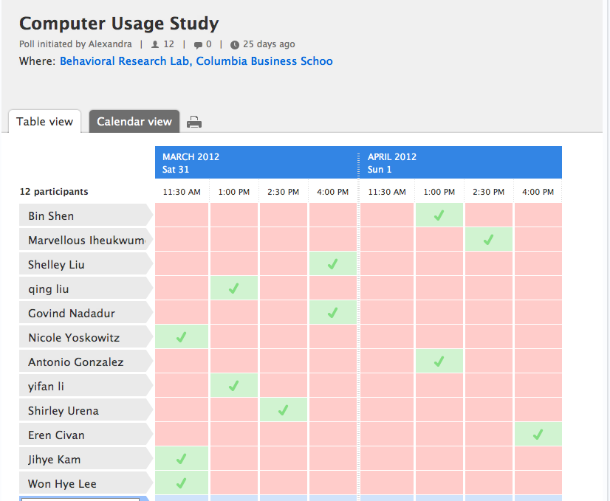
Background
Easy Scheduling provided by Doodle.com

Slide 3
Background
Ever Missed your favourite time slot?

Slide 4
Problem Scenario
31 students
Each presentation takes half an hour
They can schedule their presentations within three days (36 time slots).
3 teaching assistants select time periods they want to in charge of.

Slide 5
Goals
Making the majority of students happy
Making the number of students supervised by the teaching assistant equal(if possible)

Slide 6
Two Steps
1. Get the lowest upper bound of every TA's time slots, Za.
2. Make the most of students happy, and let the TA's upper bound still below Za.

Slide 7
Step 1: TA model
Objective:
make teaching assistant effort in the supervision of individual student projects as uniform as possible.

Slide 8
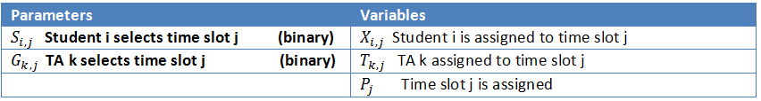
Params and Variables for a. mod

Slide 9
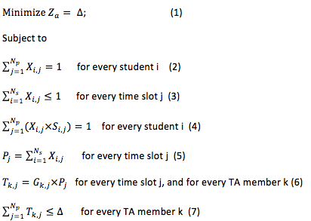
Formulas regarding TA

Slide 10
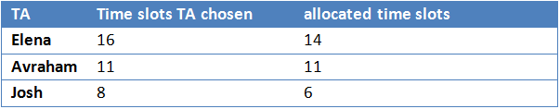
The uniformity

Slide 11
Step 2: Student Model
Objective
maximize the 'happiness' of the students.

Slide 12
Definition of 'Happiness'
Define 'Happiness' as a quantifiable and layered value:
We use 4 colors to
indicate their choices
S(i,j) integer
4 as First choice
3 as Second choice
2 as Third choice
1 as Fourth choice

Slide 13
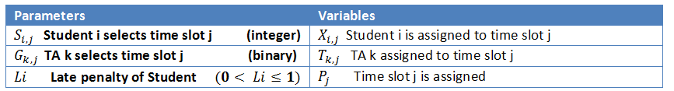
Params and Variables for b. mod

Slide 14
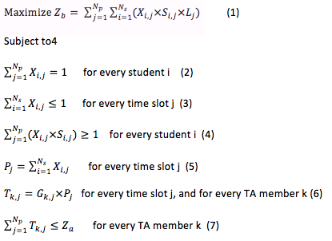
Formulas regarding student

Slide 15
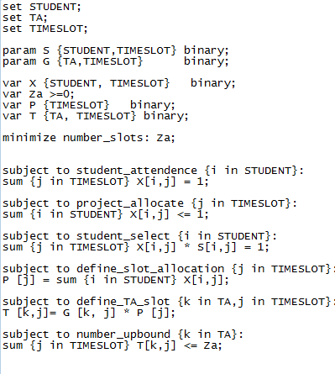
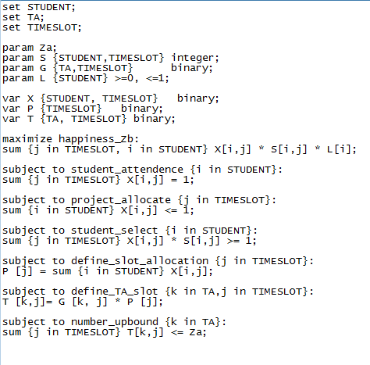
a.mod file b.mod file

Slide 16
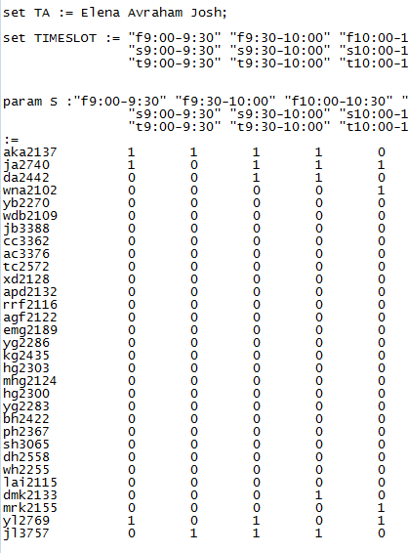
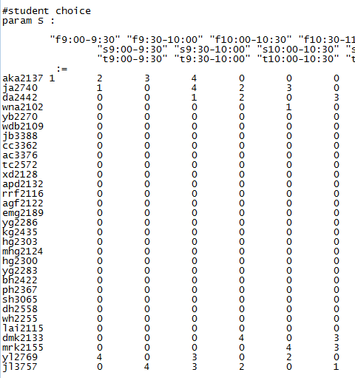
a.dat file b.dat file

Slide 17
The Systems and Running time
First, we try to run the problem on our own laptop, on Student-Edition of AMPL.
It worked at first for small inputs of five students, but failed for 31 students which has 1000+ variables, however SE of AMPL only supports 500.
Later we managed to run it on IBM desktop in IEOR lab, using CPLEXAMP solver, the running time is in seconds.

Slide 18
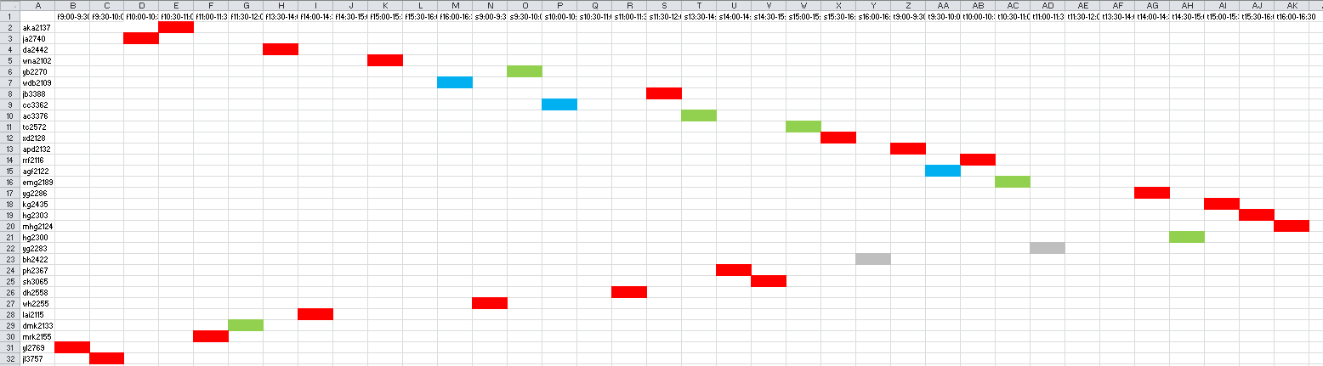
Result

Slide 19
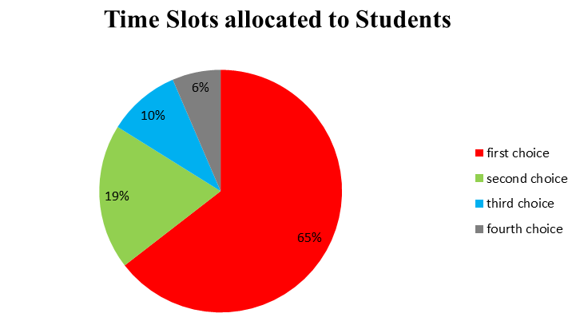
The Pie Chart

Slide 20
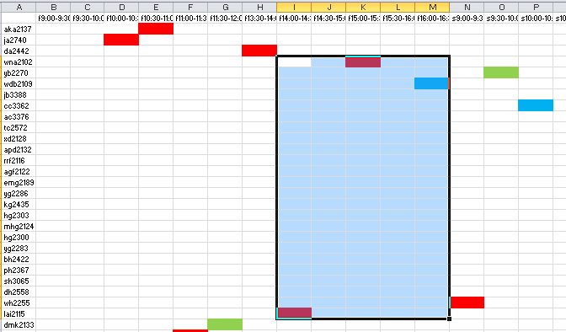
Without Late penalty

Slide 21
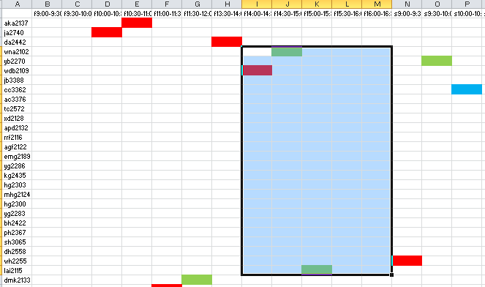
With Late Penalty on person #4

Slide 22
Conclusion/Future Work
The problem of presentation time allocation to individual students is a generic problem.
Efficient and solve easily on AMPL
Applying our integer program to large scale problems.

Slide 23
Thank you!

